Slide 1
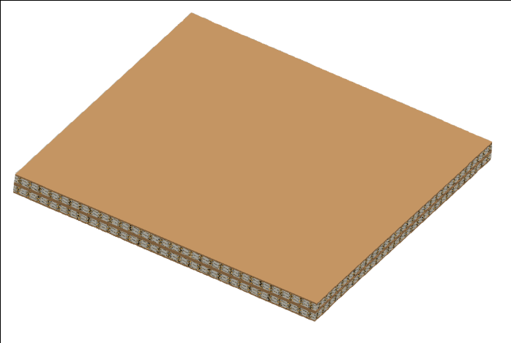
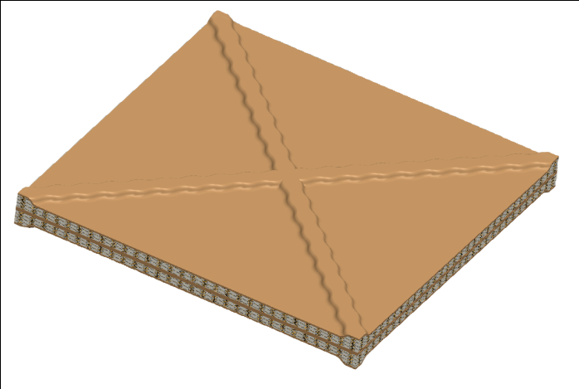
Project
Name and Department
F
Scientific Impact
ILLUSTRATIVE FIGURE
F
Figure title or brief explanation.
Objective
Key Insight/Innovation
Potential Applications

